Slide 1
Name: Sachin Shetkar Employee ID: - 201324 Unit:- 7th September AQE
Project topic: -
1. Automation using Selenium (Java) 2.Creating a CI/CD pipeline on Jenkins

Slide 2










1. Automation using Selenium (Java)
Description:-
In this Project, I fully automated the Amazon website https://www.amazon.com/ and performed test cases using testng.
Code:-
AmazonWeb.java
package com.amdocs.finalProject; import org.openqa.selenium.By;
import org.openqa.selenium.WebDriver;
import org.openqa.selenium.WebElement;
import org.openqa.selenium.chrome.ChromeDriver; import org.openqa.selenium.edge.EdgeDriver; import org.openqa.selenium.firefox.FirefoxDriver; import org.openqa.selenium.interactions.Actions;
public class AmazonWeb {
public static String browser = "Firefox";
public static WebDriver dr;
public static void main(String[] args) { if(browser.equals("Chrome")) {
dr =new ChromeDriver();
}else if(browser.equals("Firefox")) { dr=new FirefoxDriver();
}else if(browser.equals("Edge")) { dr=new EdgeDriver();
}
try {
dr.get("https://www.amazon.com"); dr.manage().window().maximize();

Slide 3
















WebElement searchBox dr.findElement(By.id("twotabsearchtextbox"));
searchBox.sendKeys("Adidas shoes"); searchBox.submit();
Thread.sleep(1000);
for (int i = 0; i < 2; i++) {
Actions actions = new Actions(dr);
actions.sendKeys(org.openqa.selenium.Keys.PAGE_DOWN).perform();
try {
Thread.sleep(1000); // Wait for a
moment after scrolling
} catch (InterruptedException e) { e.printStackTrace();
}
}
adjust the locator) WebElement firstResult =
dr.findElement(By.cssSelector(".widgetId\\=search-results_12 > div:nth-child(1) > div:nth-child(1) > div:nth-child(2) > div:nth- child(1) > h2:nth-child(1) > a:nth-child(1) > span:nth-child(1)"));
firstResult.click();
Thread.sleep(2000);
dr.findElement(By.xpath("/html/body/div[1]/div/div[5]/div[2]/div
[1]/div[2]/div[2]/div/div/div[1]/div[13]/div[1]/div/form/div[1]/span/
span/span/span/span/span")).click();
dr.findElement(By.xpath("//*[@id=\"native_dropdown_selected_size
_name_8\"]")).click();
// Add the product to the cart
WebElement addToCartButton = dr.findElement(By.id("add-to-cart- button"));
addToCartButton.click();

Slide 4





}catch(InterruptedException e) { e.printStackTrace();
}
//Close the browser dr.close();
}
}
Amazontest.java
package com.amdocs.finalProject;
import org.openqa.selenium.WebDriver; import org.openqa.selenium.edge.EdgeDriver; import org.testng.annotations.Test;
import org.testng.asserts.SoftAssert;
public class Amazontest {
WebDriver dr= new EdgeDriver(); SoftAssert sa=new SoftAssert();
@Test
public void titletestpass() {
dr.get("https://www.amazon.com");
String expTitile = "Amazon.com. Spend less. Smile more.";
String actTitle = dr.getTitle(); System.out.println(actTitle);
System.out.println(dr.getTitle()); sa.assertEquals(actTitle, expTitile);
}
}
Screenshots:-
Amazon website step-by-step automation screenshots

Slide 5
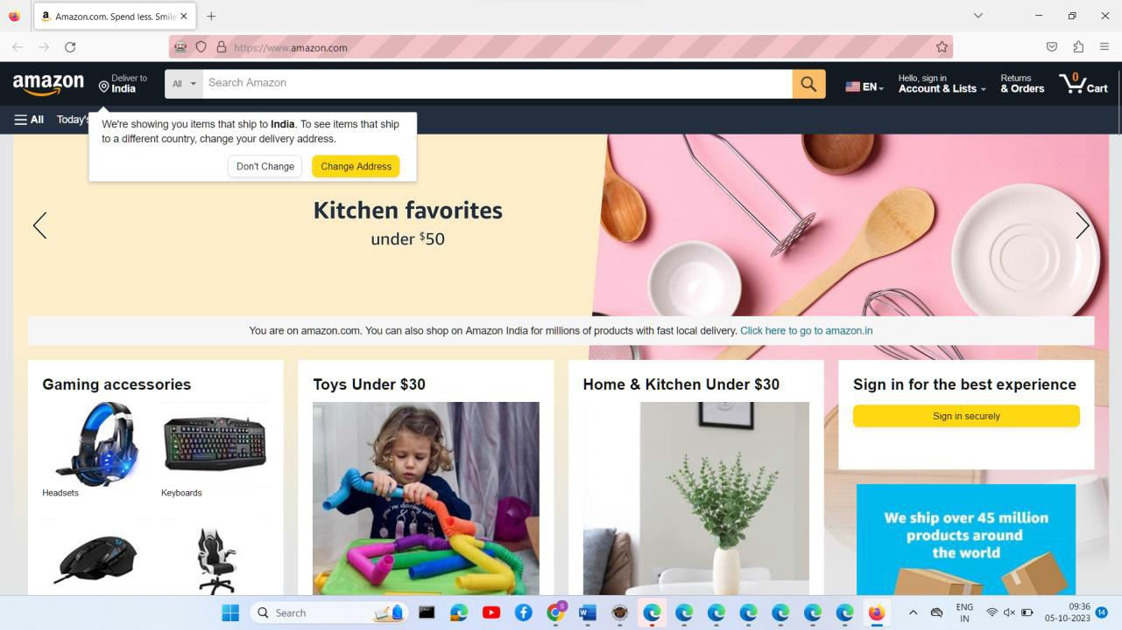
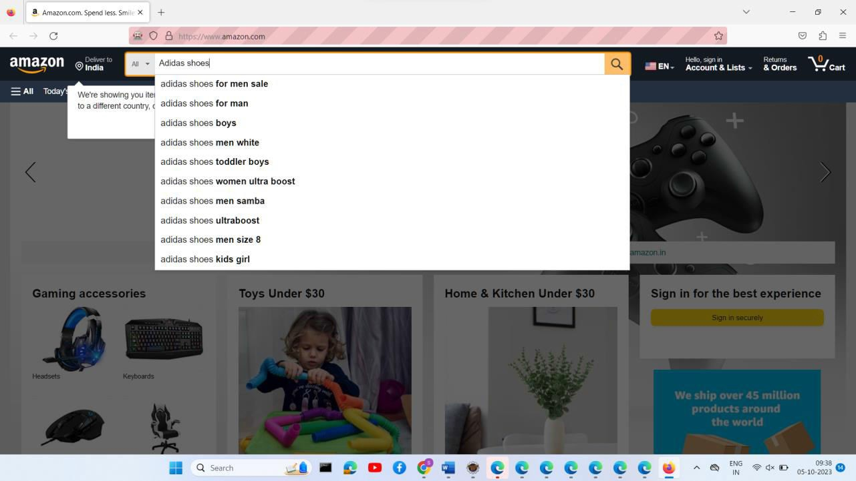

Slide 6
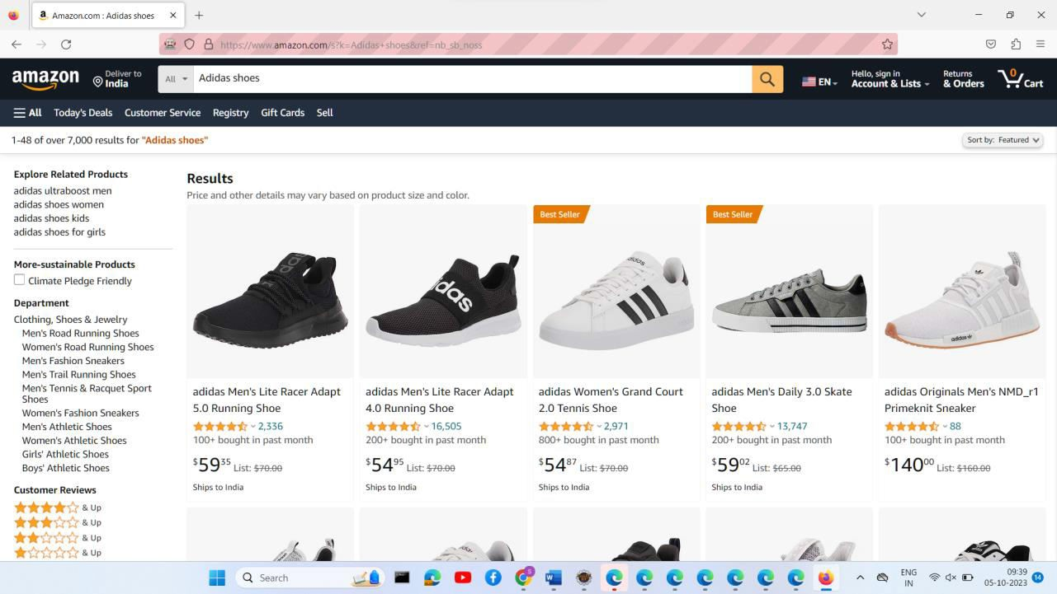
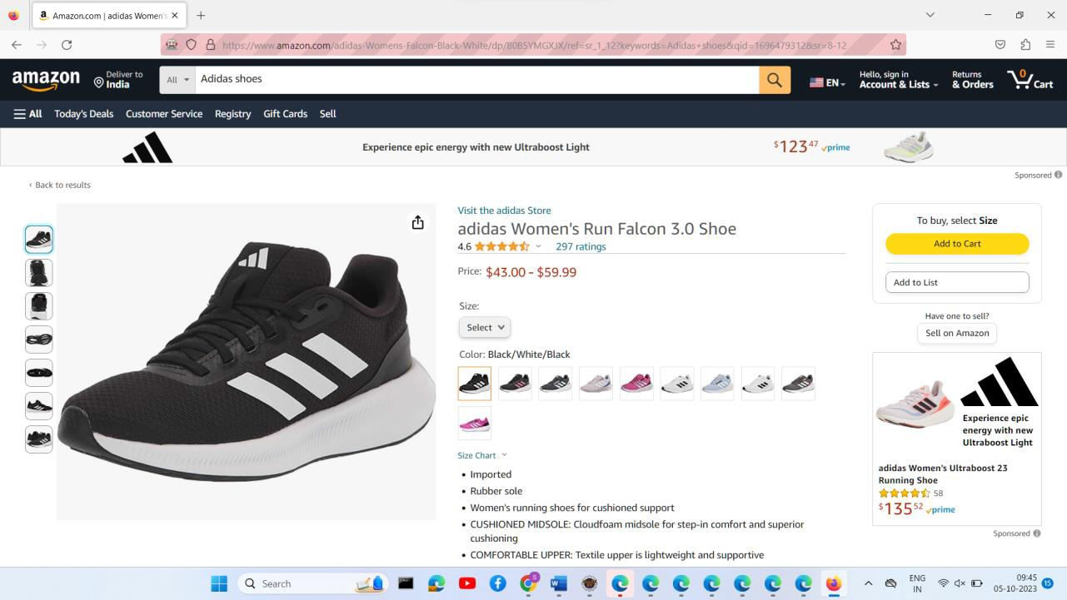

Slide 7
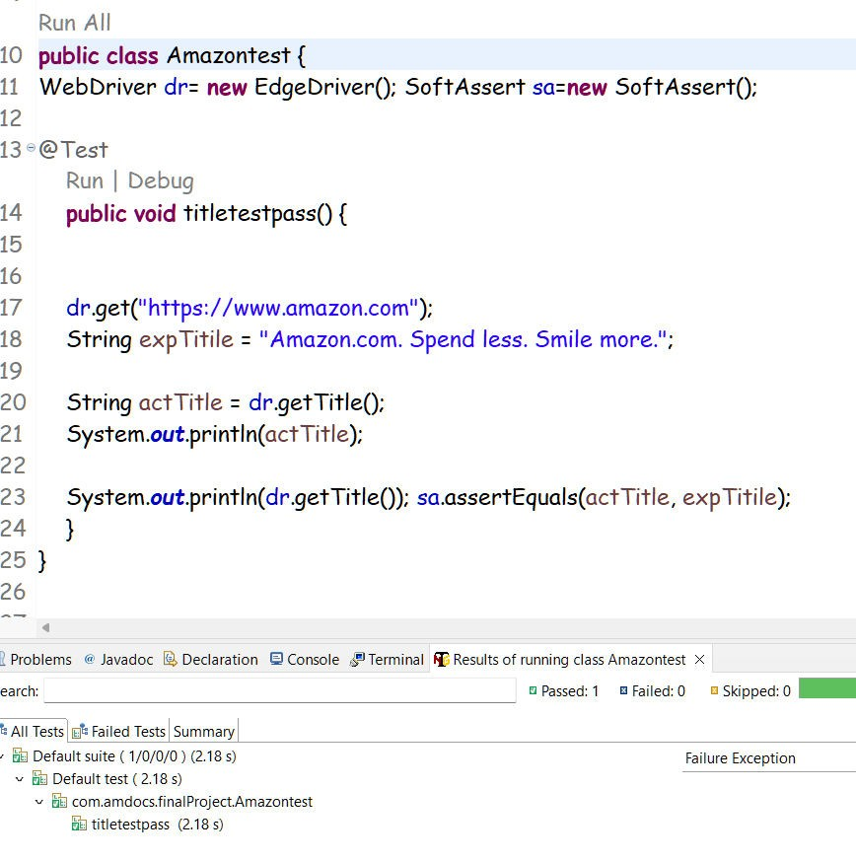
TestNG testcases Screenshots

Slide 8
2)Creating a CI/CD pipeline on Jenkins
Code:-
MyController.java :-
package com.final Project. finalProjectAQE;
import org.springframework.web.bind.annotation.GetMapping; import org.springframework.web.bind.annotation. RestController;
@RestController
public class My Controller {
@GetMapping("/get") public String handleGetRequest() { return "Welcome to Amdocs";
}
@GetMapping("/in")
public String handleInRequest() { return "We are going to run project on jenkins";
}
}

Slide 9
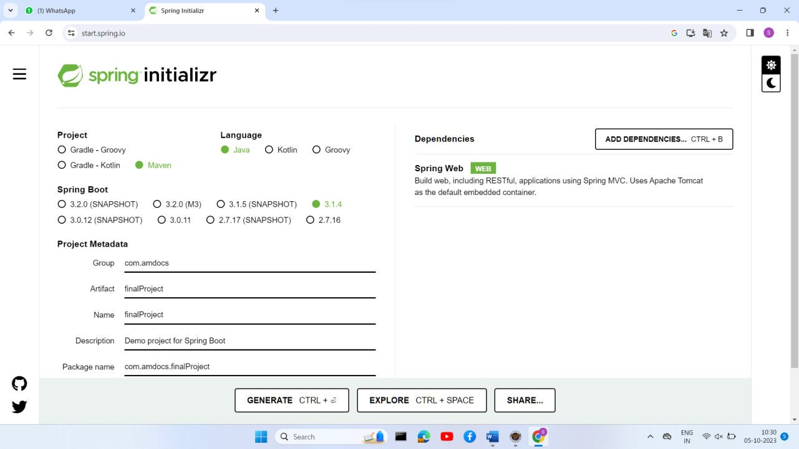
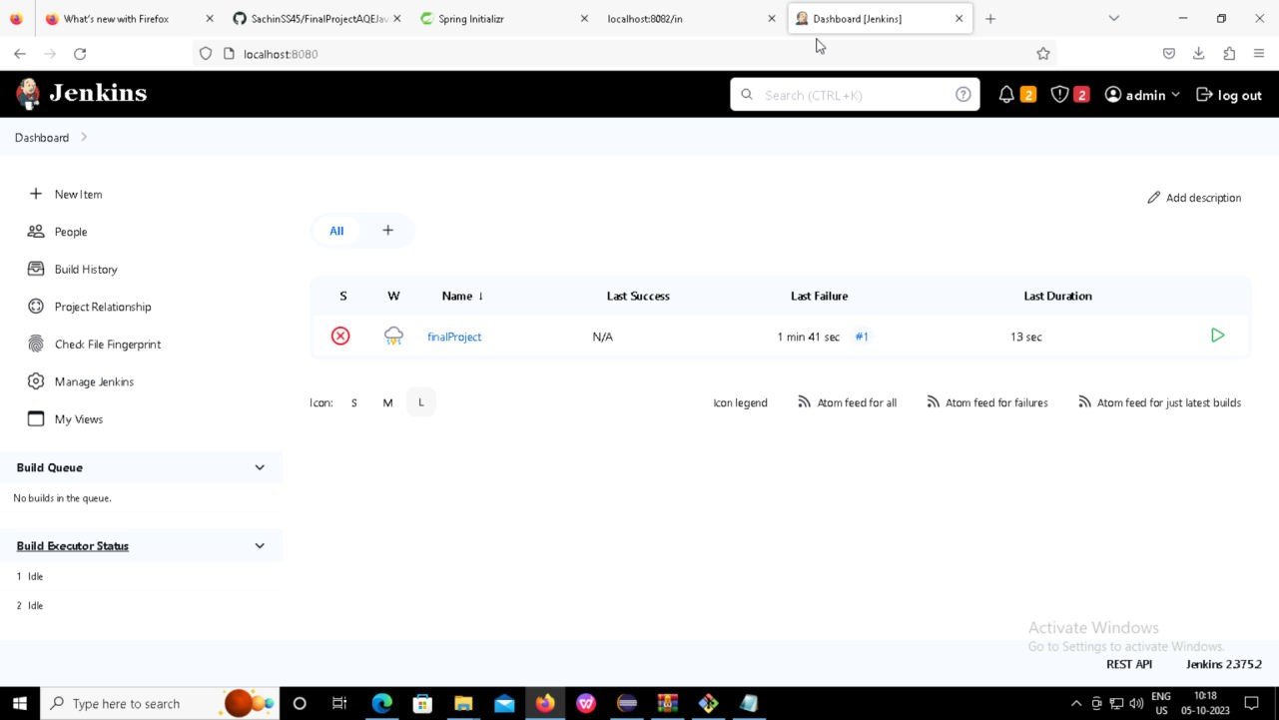
First created a Spring boot project and added our necessary code

Slide 10
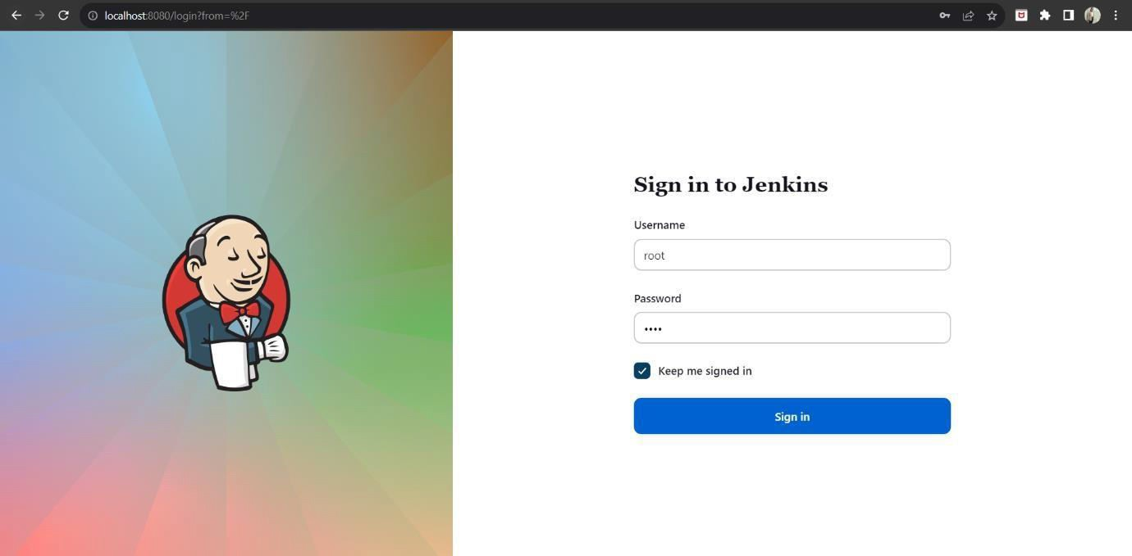
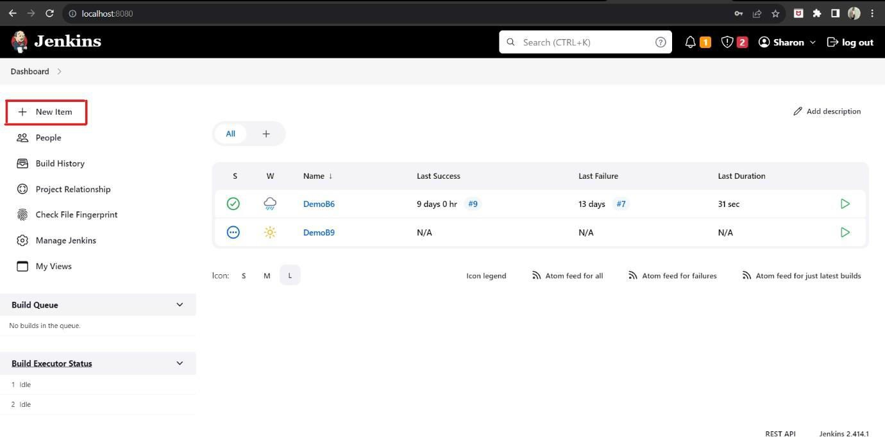
You can see the changes are reflected on jenkins as well.

Slide 11
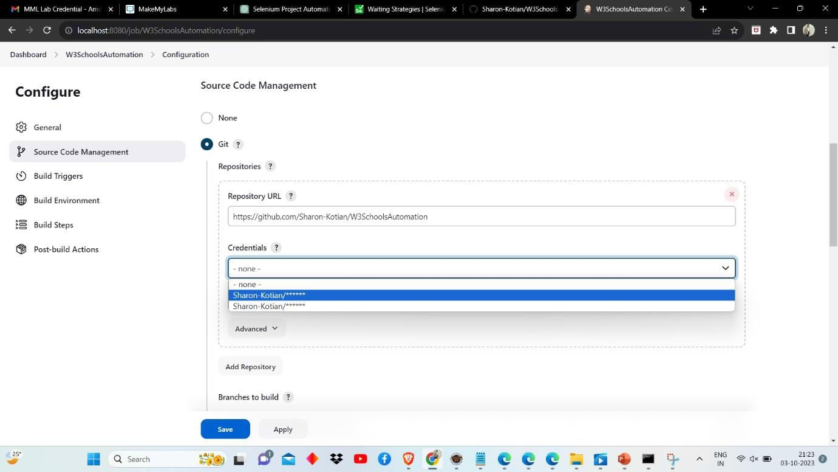
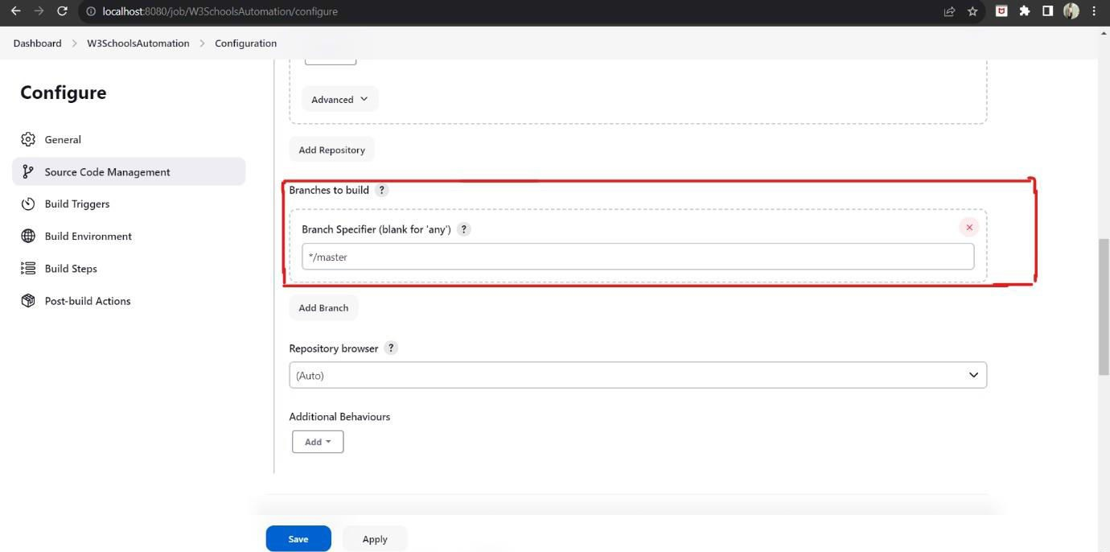

Slide 12
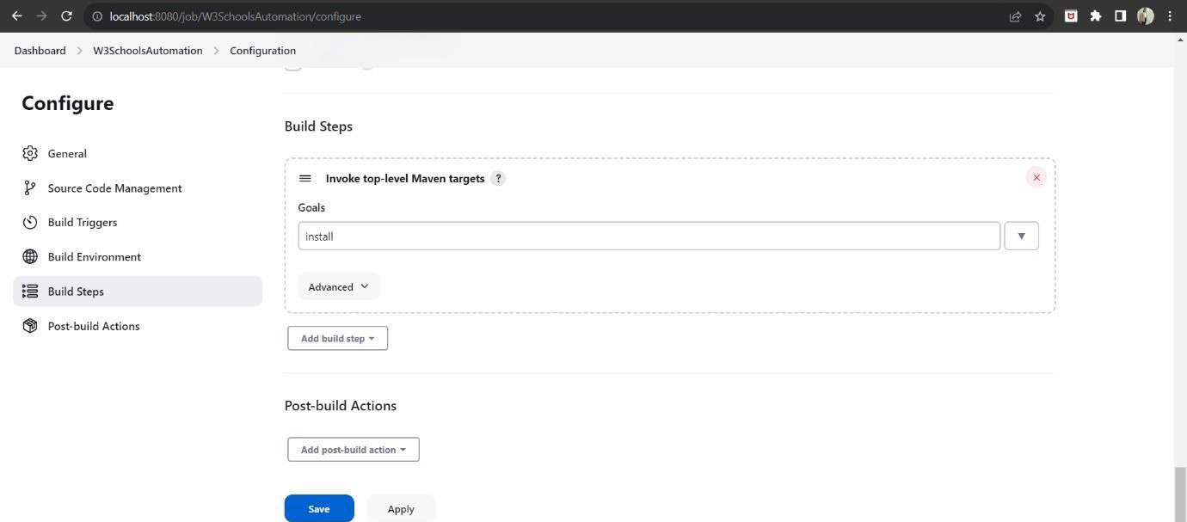

Slide 13
THANK YOU

